Slide 1


Deep Learning
Image Classification with CNN
Group: Null
Azzam Saud AlHarbi - Ahmad Alsubhi - Abdulrahim Aljadani

Slide 2


Dataset
Animals-10
It contains about 28K medium quality animal images belonging to 10 categories: dog, cat, horse, spyder, butterfly, chicken, sheep, cow, squirrel, elephant.

Slide 3
Topic
Description of the chosen CNN architecture.
Explanation of preprocessing steps.
Details of the training process (e.g., learning rate, batch size, number of epochs).
Results and analysis of models performance.
What is your best model. Why?
Insights gained from the experimentation process.

Slide 4
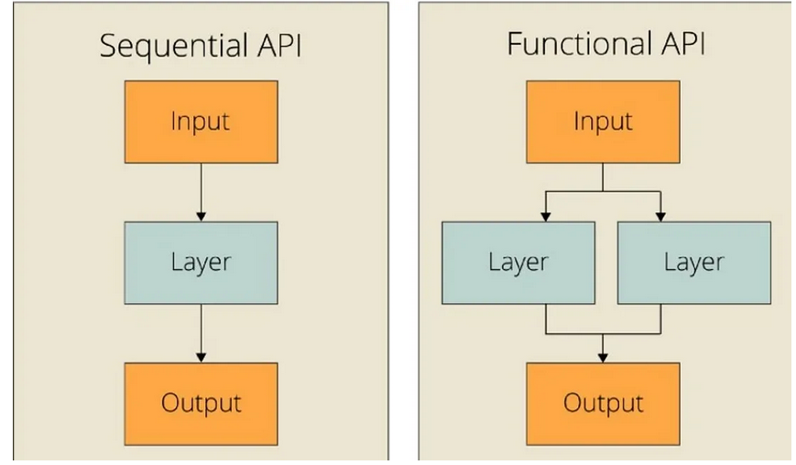
Description of the chosen CNN architecture
Sequential :
- 3 convolutional layers
Image size : 128 as it is a light model
Pooling and dropout used to prevent overfitting
Functional :
4 convolutional layers
Image size : 224
Pooling Layers: 4 layers (3 MaxPooling and 1 Global Average Pooling)
dropout layer in each convolutional block (Conv Block)

Slide 5





Explanation of preprocessing steps
Reading Data
Resizing and Normalization
Evaluation
Model training
train_test_split

Slide 6
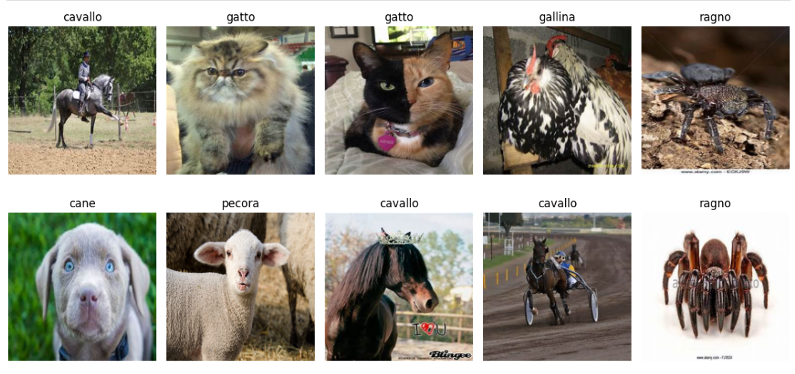
Explanation of preprocessing steps
Visualizing some images

Slide 7
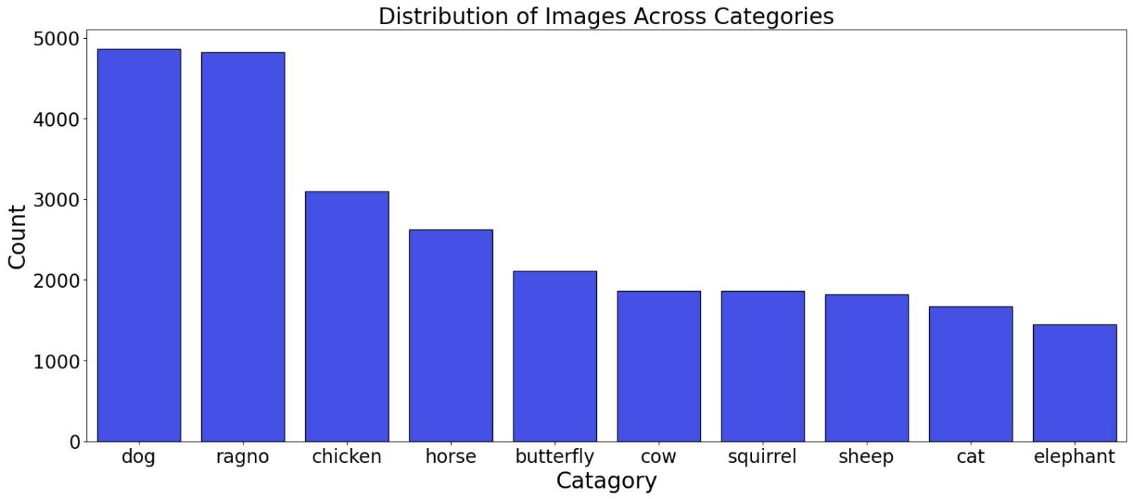
Distribution of Images Across Categories

Slide 8
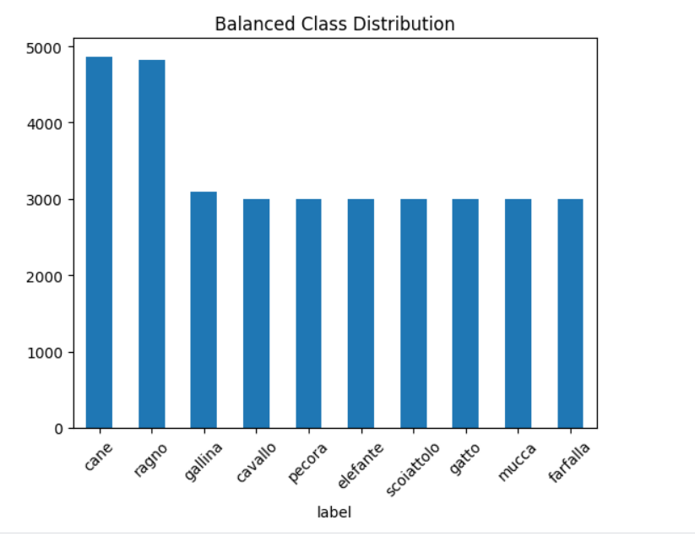
Distribution of Classes After Augmentation

Slide 9
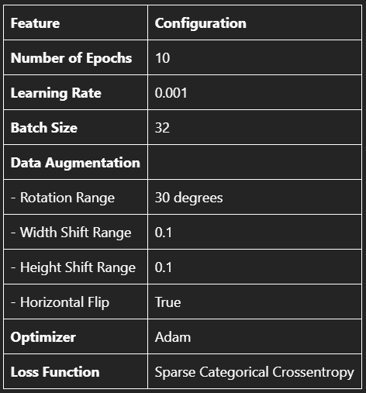
Details of the training process

Slide 10
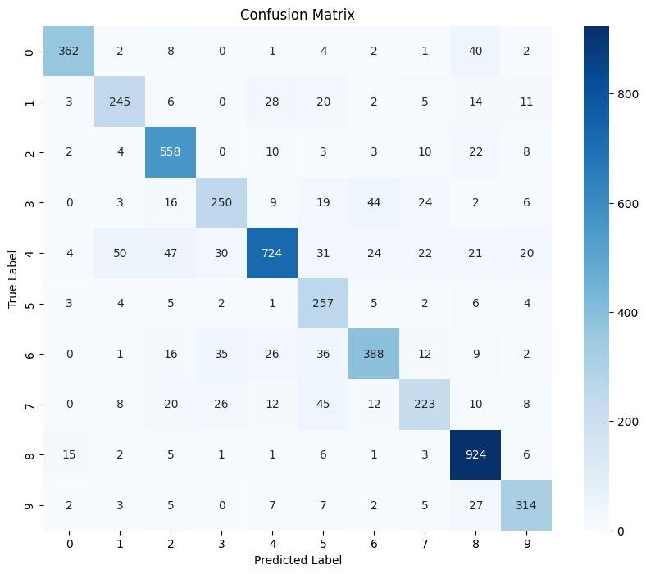
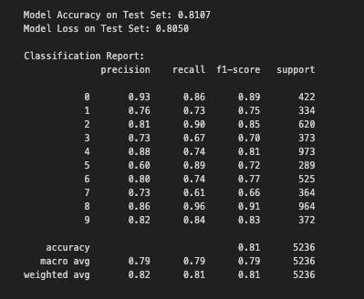
Results and Analysis of Models Performance
CNN Functional API model

Slide 11
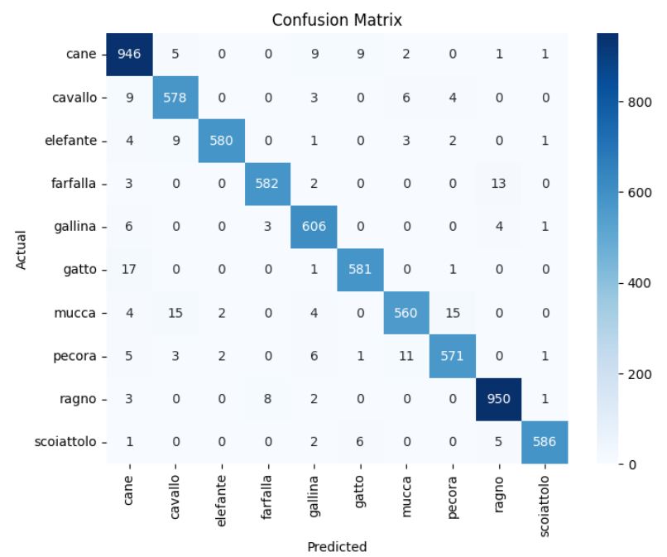
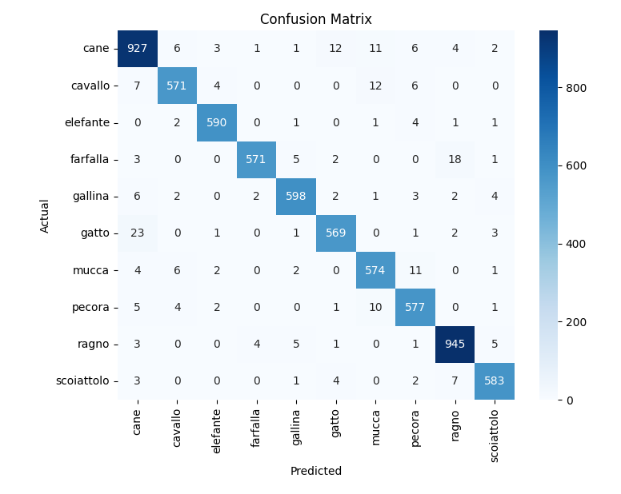
Results and Analysis of Models Performance
InceptionV3
EficientNetB6
Accuracy : 97%
Accuracy : 95%

Slide 12
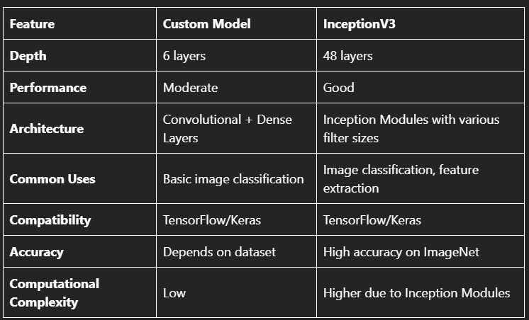
What is your best model. Why?
InceptionV3
Efficient in computational resources.
Uses multiple convolution filter sizes.
Processes multiple scales in parallel.

Slide 13
Insights gained from the experimentation process
Pre-trained Models:
EfficientNetB6: Efficient with advanced techniques for parameter usage.
InceptionV3: Uses multiple filter sizes for enhanced feature extraction.
Results:
Pre-trained models outperform regular CNN models, with transfer learning significantly improving performance.
Inception faster in training time compared to EfficientNetB6

Slide 14
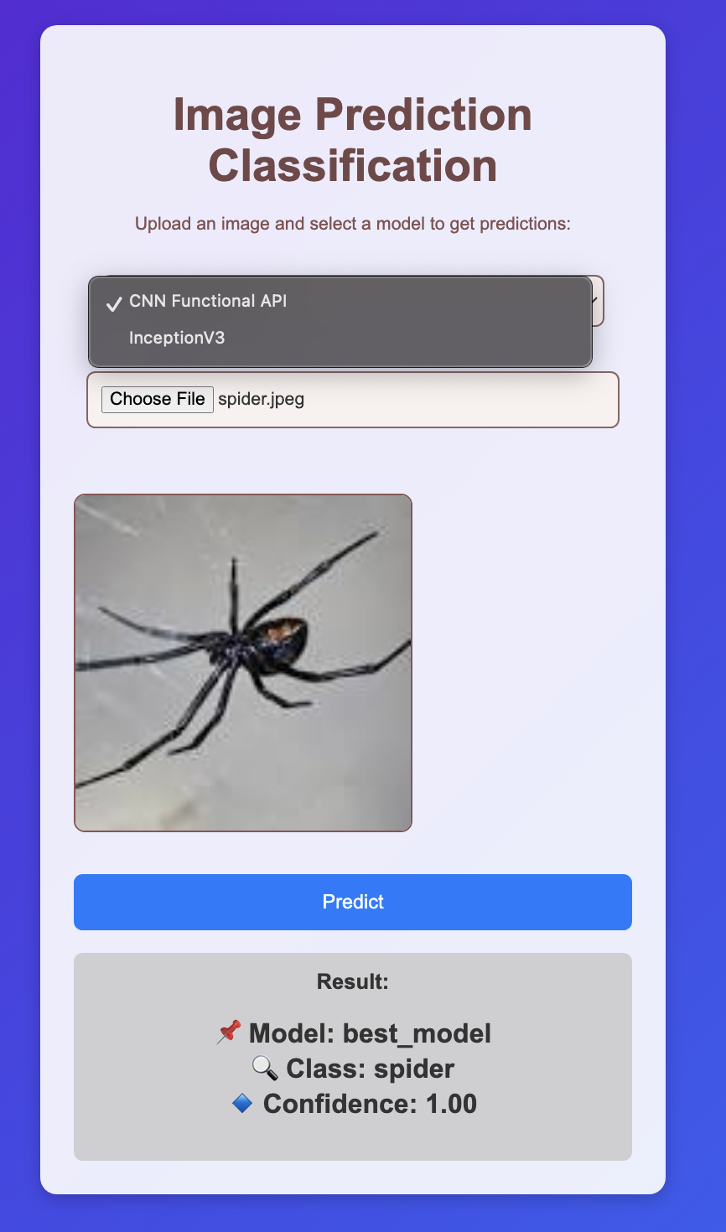

Slide 15


Demo
FastAPI
HTML/CSS/JS
Work ✅
Not working 🤷‍♂️

Slide 16
Thank You!
Thank you for exploring the world of AI with us.
Null Team
Azzam Saud AlHarbi - Ahmad Alsubhi - Abdulrahim Aljadani

